Slide 1
NELA, a local perspective
Improving mortality & patient care using national data, QI and teamwork
Medway Maritime Hospital
Dr. Sarah Hare
Consultant Anaesthetist

Slide 2
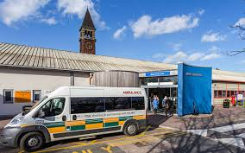
Total Laparotomies per year;
Year 1 = 164
Year 2 = 197
Year 3 = 182 (year to date)
Notes:
Based in Chatham, Medway is the largest single hospital in Kent with 720 beds and with an annual turn over of £215 million. We have 500,000 patient contacts each year, and
26% of our patients are obese, 21% of children are in low income households, 22 % smoke, and we have a 1 year les than average life expectancy (the patients, who knows about the staff)

Slide 3
A very ‘special’ hospital
CQC Special measures since July 2013
Re-inspected August 2015
CQC field work visits March 2016
High turn over of staff at all levels
New Executive and non executive team
New permanent Chief Executive in May 2015
Largest financial deficit per population in England
Notes:
Under intense scrutiny

Slide 4
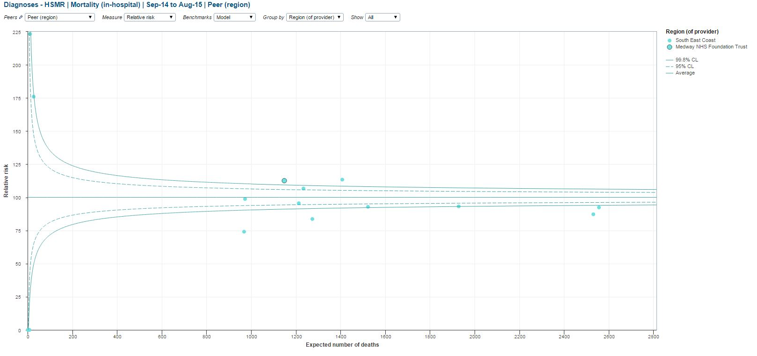
Medway Mortality
HSMR 120
Jan 2014

Slide 5
Laparotomy Mortality
Year 1 = 22%
Quality of care
Safe
Effective
Efficient
Patient Centered
Timeliness
Equitable
✗

Slide 6
NELA – the unloved audit
90 sets of notes outstanding at the end of Year 1
Retrospective, inaccurate data
Chaotic, unpredictable care
Non standardised, variable care
But probably reflected our situation
Seen as ‘another audit’
Anaesthetic owned – silo working
Notes:
Problems are not unique but required a lot of work to over come.
Established a multidisciplinary ELC steering group consisting of Anaesthetists, Surgeons, Critical Care, Nurses and Quality team.
Very importantly in the team are a Lead Anaesthetic Registrar, Jamie Mann and Lead Surgical Registrar Clare Hammer who were key to driving many of the changes that have been successfully implemented. They were crucial in developing strategies that were fit for purpose at the Junior Doctor level and this developed a key communication channel.
Their first task was to ensure that when we asked any junior surgeon/anaesthetist ‘what is NELA/ELC they would know the answer!’
Once the juniors were on board, many of the quality improvement tools were self perpetuating and the added bonus of coffee & muffins for the leading Team at completing the NELA data has had astonishing effects.
This was important because our NELA data colelction had been sporadic over the previous year meaning that it was difficult to make any conclusions in a monthly fashion as to progress. Now our NELA data is regularly and more reliably compelted allowing us to provide monthly infographics and updates to all Surgeons and Anaesthtists.
Our starting Mortality was not good. It was almost unmentionable. 19%. However our mortality for September – December had improved dramatically to 9% Now the Consultant Surgeons are proud of their work and this has had a knock on effect of engaging and enthusing our consultant surgeons even further so they are motivated to keep delivering good care. They are proud of the fact their patients are receiving such improved care.
They attend 100% of cases from September to December – the Anaesthetists have been harder to engage. They are required to attend all Laparotomies with P Possum > 5%. We have astaffing problem on Monday – Friday on CEPOD and these are often run by staff grades. ON NELA this means that we do not have 100% Consultant Anesthetists attendance. However, we have broken the data down further and found that we only have 70% attendance for laparotmies out of hours and at weekends. This data has been used to support business cases for funding for recruitment of new Consultnat Anaesthetists.
Junior Doctors – Similar to the Consultants as they have seen the data infographics to demonstrate their performance their competitive type A personalities have been jolted in to action and they have been more proactive at completing boarding passes (no patient can be booked for CEPOD without one)
Another Key method of helping improve our performance was engaging the CEPOD nursing staff and team. We recruited to our ELC steering group a keen enthusiastic CEPOD nurse and a night HCA – they have offered ongoing support and reminders about timeliness of operating asap on our laparotomies, completion of NELA, utilising our WHO check list time out (GDT use and NELA patient reminder) and sign out (please complete NELA/this patient is going to HDU/ICU for further management).
Nurse awreness – part of our team is a Nurse Quality Improvement facilitator. She has produced credit sized info cards for our surgical nurses and is working on methods to engage our surgical nurses further. They will be a key part in advocating rapid assessment, correct work up and recognition of the sick laparotmy patient on the ward preoperatively.

Slide 7
In the beginning
Poor data collection – inaccurate, untimely
No team to ‘buy in’
NELA – no one knew what it was about
No clear care pathway for patients
Poor utilisation of risk stratification
The unloved project

Slide 8
Problem list.
Consultant buy in – Anaesthetists & Surgeons
Junior Doctor buy in – Why should we fill in Nela? We are far too busy.
CEPOD Theatre awareness
Nurse awareness – What is ELC/NELA?
Recognition of the sick laparotomy patient – They don’t look too bad, we’ll operate tomorrow maybe..
Notes:
Problems are not unique but required a lot of work to over come.
Established a multidisciplinary ELC steering group consisting of Anaesthetists, Surgeons, Critical Care, Nurses and Quality team.
Very importantly in the team are a Lead Anaesthetic Registrar, Jamie Mann and Lead Surgical Registrar Clare Hammer who were key to driving many of the changes that have been successfully implemented. They were crucial in developing strategies that were fit for purpose at the Junior Doctor level and this developed a key communication channel.
Their first task was to ensure that when we asked any junior surgeon/anaesthetist ‘what is NELA/ELC they would know the answer!’
Once the juniors were on board, many of the quality improvement tools were self perpetuating and the added bonus of coffee & muffins for the leading Team at completing the NELA data has had astonishing effects.
This was important because our NELA data colelction had been sporadic over the previous year meaning that it was difficult to make any conclusions in a monthly fashion as to progress. Now our NELA data is regularly and more reliably compelted allowing us to provide monthly infographics and updates to all Surgeons and Anaesthtists.
Our starting Mortality was not good. It was almost unmentionable. 19%. However our mortality for September – December had improved dramatically to 9% Now the Consultant Surgeons are proud of their work and this has had a knock on effect of engaging and enthusing our consultant surgeons even further so they are motivated to keep delivering good care. They are proud of the fact their patients are receiving such improved care.
They attend 100% of cases from September to December – the Anaesthetists have been harder to engage. They are required to attend all Laparotomies with P Possum > 5%. We have astaffing problem on Monday – Friday on CEPOD and these are often run by staff grades. ON NELA this means that we do not have 100% Consultant Anesthetists attendance. However, we have broken the data down further and found that we only have 70% attendance for laparotmies out of hours and at weekends. This data has been used to support business cases for funding for recruitment of new Consultnat Anaesthetists.
Junior Doctors – Similar to the Consultants as they have seen the data infographics to demonstrate their performance their competitive type A personalities have been jolted in to action and they have been more proactive at completing boarding passes (no patient can be booked for CEPOD without one)
Another Key method of helping improve our performance was engaging the CEPOD nursing staff and team. We recruited to our ELC steering group a keen enthusiastic CEPOD nurse and a night HCA – they have offered ongoing support and reminders about timeliness of operating asap on our laparotomies, completion of NELA, utilising our WHO check list time out (GDT use and NELA patient reminder) and sign out (please complete NELA/this patient is going to HDU/ICU for further management).
Nurse awreness – part of our team is a Nurse Quality Improvement facilitator. She has produced credit sized info cards for our surgical nurses and is working on methods to engage our surgical nurses further. They will be a key part in advocating rapid assessment, correct work up and recognition of the sick laparotmy patient on the ward preoperatively.

Slide 9
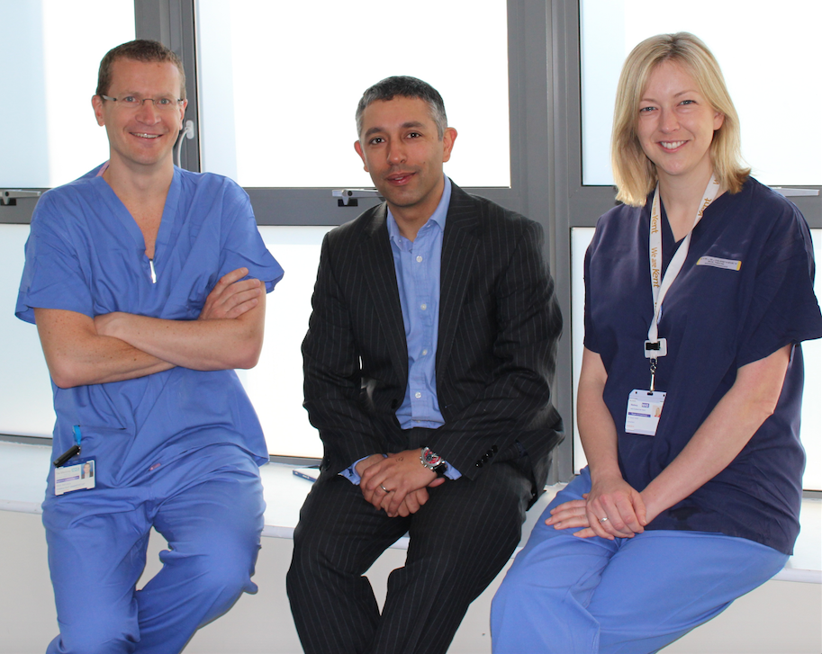
Moving from audit to QI
Team leaders; set up of key stakeholders who can effect change

Slide 10
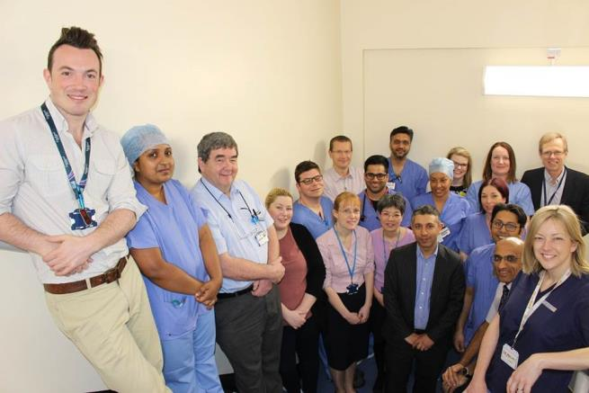
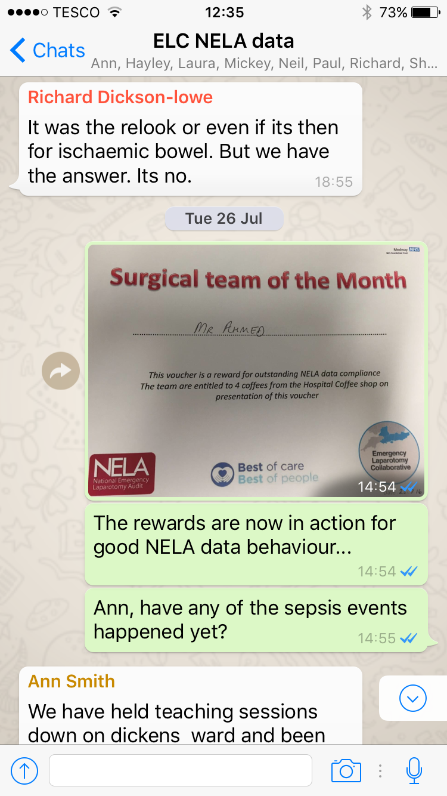
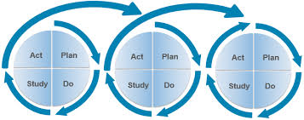
Engaging our MDT
Emergency Laparotomy Team
Face to face meetings
Email meetings….
Notes:
Consultant led
Registrar leads
Clinical audit and effectiveness analysts
Theatre nurses
QI nurses
Radiologists & radiographers
Ward nurses
ED

Slide 11
Goals of our NELA action group
Making it easier to deliver high standards of care
Use of effective risk stratification
Reduce the number of steps to get a patient to theatre safely & efficiently
Enable teams to function
Use our data to effect change
Notes:
Avoid data for data’s sake
Enable people to deliver the care that they want to be able to deliver
No one comes to work to do a bad job but the system fails them and our patients

Slide 12
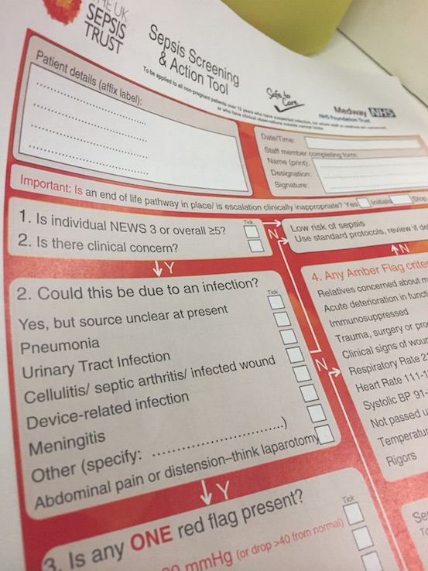
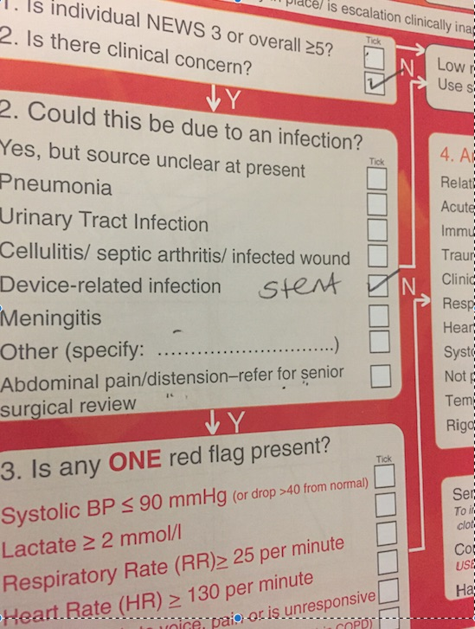
Joined up thinking
Developing strategies that fit with the Trusts Recovery Plan & other initiatives
Notes:
Deteriorating patient
Simulation centre
Sepsis 6

Slide 13
The Emergency Laparotomy Collaborative
Aim to encourage collaboration and embed a knowledge of quality improvement to improve the mortality of emergency abdominal surgery
6 key themes using a care bundle approach
ELC aims to save 1000 lives over two years.
Notes:
Use of an Early Warning Score (EWS) or lactate to identify patients most at risk for deterioration and the delivery of prompt resuscitation for these patients.
Use of a sepsis screening tool to identify septic patients and treatment with Sepsis Six.
Definitive surgery within 6 hours of decision to operate for patients categorised as Level 1 and 2a in urgency.
Appropriate dynamic fluid resuscitation and optimisation using goal-directed fluid therapy.
Postoperative critical care (Level 2 or 3) for all patients.
Consultant delivered care throughout the perioperative journey

Slide 14
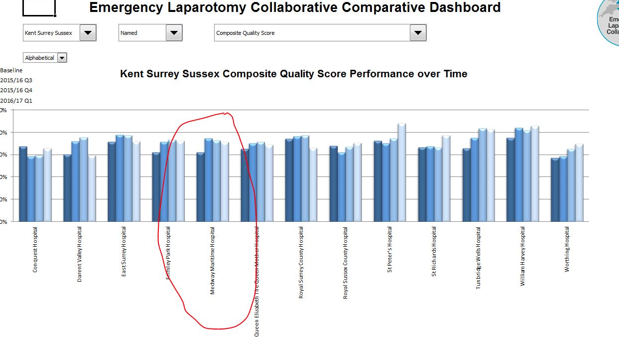

Slide 15
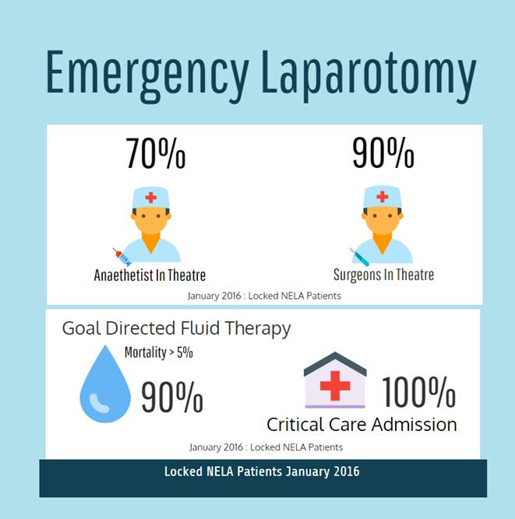
Using data to create change
Notes:
This is the most recent infographic we sent out last week to update everyone
Aim is to have a clear presentation of data focussing on different topics every month
Prior to the education sessions on GDT we only used it 70% of the time, this is an improvement that is now demonstrated to the anaesthetic department that they are pleased with.
The surgeons have slipped slightly from 100% which fuelled much discussion amongst them as to ‘who did not come in and changed our 100% data’ – peer review can be very influential!
The surgeons are also now very vocal about inviting their Consultant anaethetist colleagues to join them in theatre.

Slide 16
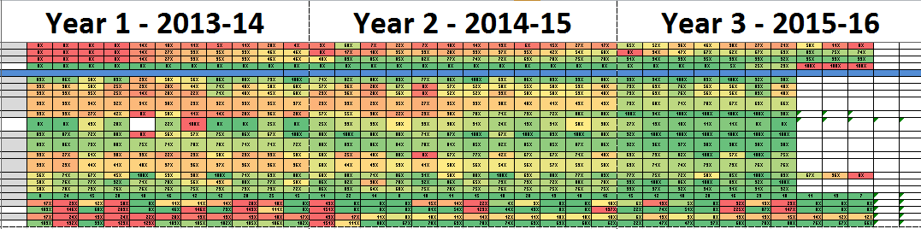
Learning from our data
Notes:
One of the single most important changes has been the heightened awareness of all members of the multidiscipliary team of the importance of high quality care for laparotomies. This has helped enforce a new attitude towards the care of these patients because high performance is starting to be the accepted normal behaviour at Medway rather than the notorious ‘Medway Way’ of old. We hope to keep reinfocing this further by continuing raising awareness, continuing education, continuing working hard to keep the team engaged. Our mortality slipped from 9% to 10% in January and this has been an important tool after seeing so much improvement previously in motivating everyone to keep working at the project.

Slide 17
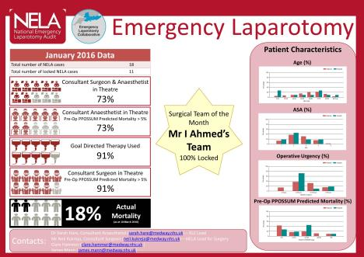
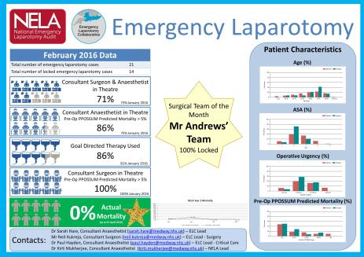
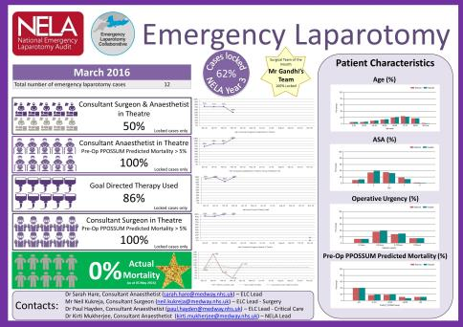
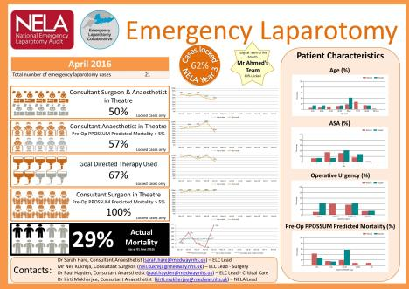
Notes:
What is important now is that our data is current and relevant. Yearly reports to benchmark ourselves against other Hospitals can be useful, but waiting for a yearl report is too long to effect any meaningful change other than a knee jerk reaction. We had two spikes in mortality this year above our expected levels but because our data is contemperanoues we knew before any national or local reports and were already acting upon it.
Changed M&M reviews, joint presentations
Recognised we have aproblem with delaying patietnsbeing recognised for needing surgery

Slide 18









`
April 2016: What Went Wrong?
Number of laparotomies | Number of deaths | Mortality rate | Observed vs Expected Mortality
21 | 6 | 29% | 211%
Observed vs Expected Mortality:
This is calculated using the following formula:
Number of deaths / Sum of Pre-Op P-POSSUM Predicted Mortality
Pre-op P-POSSUM calculated
Identifying the patient’s risk correctly ensures high risk patients are identified early. All of these patients were high risk with a P-POSSUM predicted mortality > 5%.
Explanatory Notes
83%
Each icon of the infographic corresponds to an individual patient; the patients are in the same sequence in each infographic.
Pre-op P-POSSUM should be calculated in real time using the NELA data entry tool.
Pre-op risk prediction correct
66%
Theatre within NCEPOD timeframe
Further to this review, a new work stream is being developed to address this issue.
If the time between decision to operate and arrival at theatre was less than the upper end of the NCEPOD urgency assigned to a patient, they met this standard.
33%
Consultant Surgeon Present
All patients had a documented risk of > 5%; consultant presence should therefore have been mandated.
Contacts:
Dr Sarah Hare, Consultant Anaesthetist: ELC Lead (sarah.hare@medway.nhs.uk)
Mr Neil Kukreja, Consultant Surgeon ELC Lead – Surgery (neil.kukreja@medway.nhs.uk)
Dr Paul Hayden, Consultant Anaesthetist; ELC Lead – Critical Care (paul.hayden@medway.nhs.uk)
Dr Kirti Mukherjee, Consultant Anaesthetist; NELA Lead (kirti.mukherjee@medway.nhs.uk)
100%
Consultant Anaesthetist Present
83%
Goal Directed Therapy
The Gold Standard for managing fluid balance correctly is using ODM/LidCo. This reduces complications and Length of Stay for Laparotomy patients.
83%
ICU/HDU
The Protocol at Medway is for ALL post-laparotomy patients to go to HDU/ICU. If this does not happen, please call the ICU consultant on call to discuss.
100%
End of Life Care

Slide 19
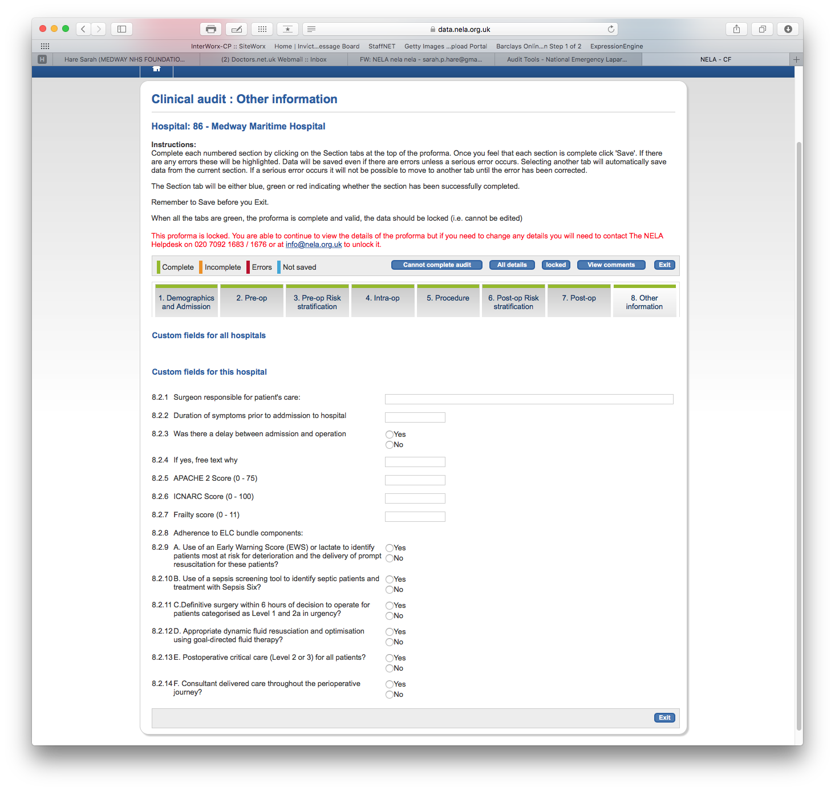

Slide 20
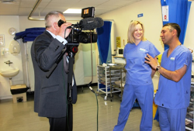
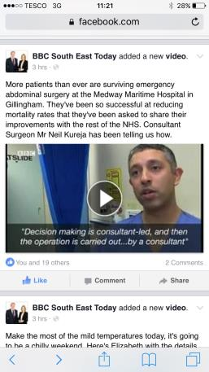
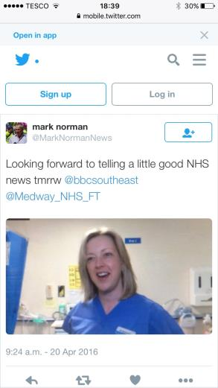
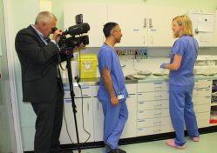
Spreading the word

Slide 21
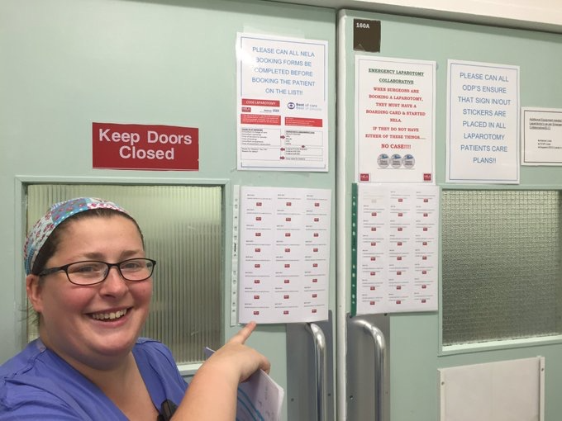
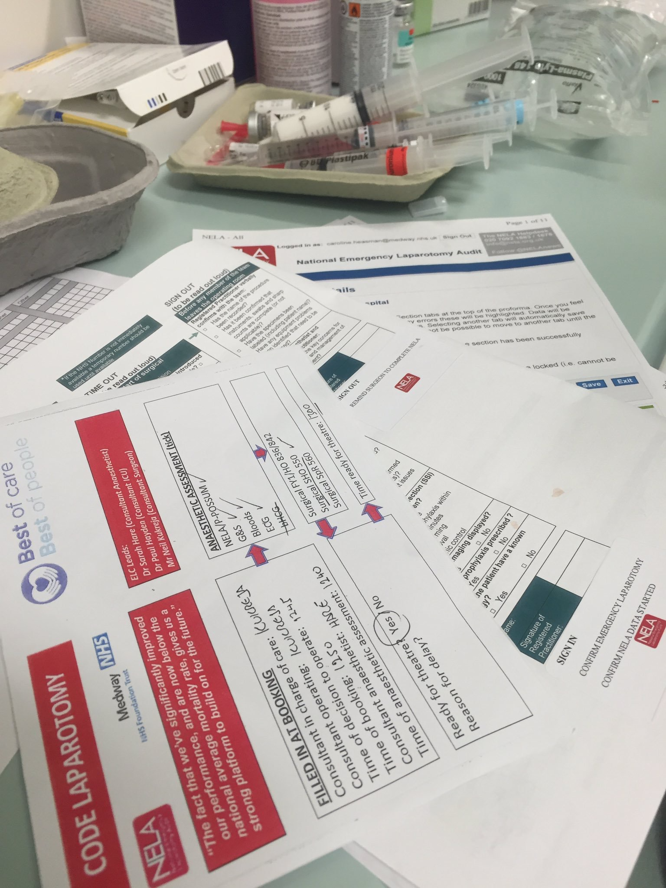
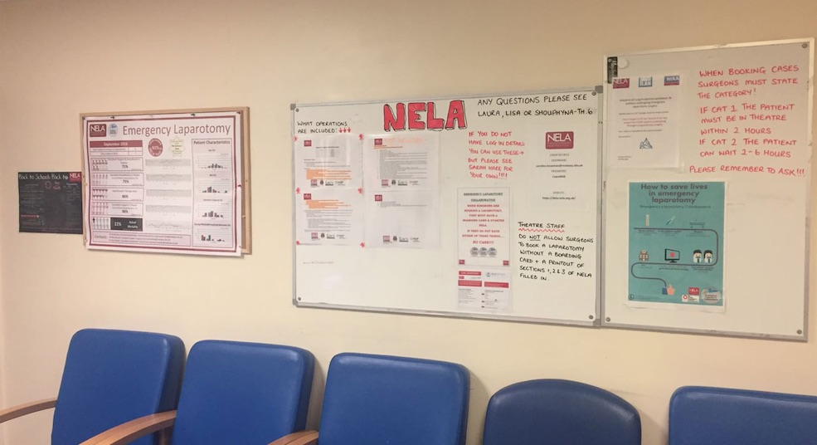
NELA nudges
Notes:
Code laparotomy stickers
NELA nudges
WHO check list addition stickers
Evolving boarding cards – PDSA cycles

Slide 22
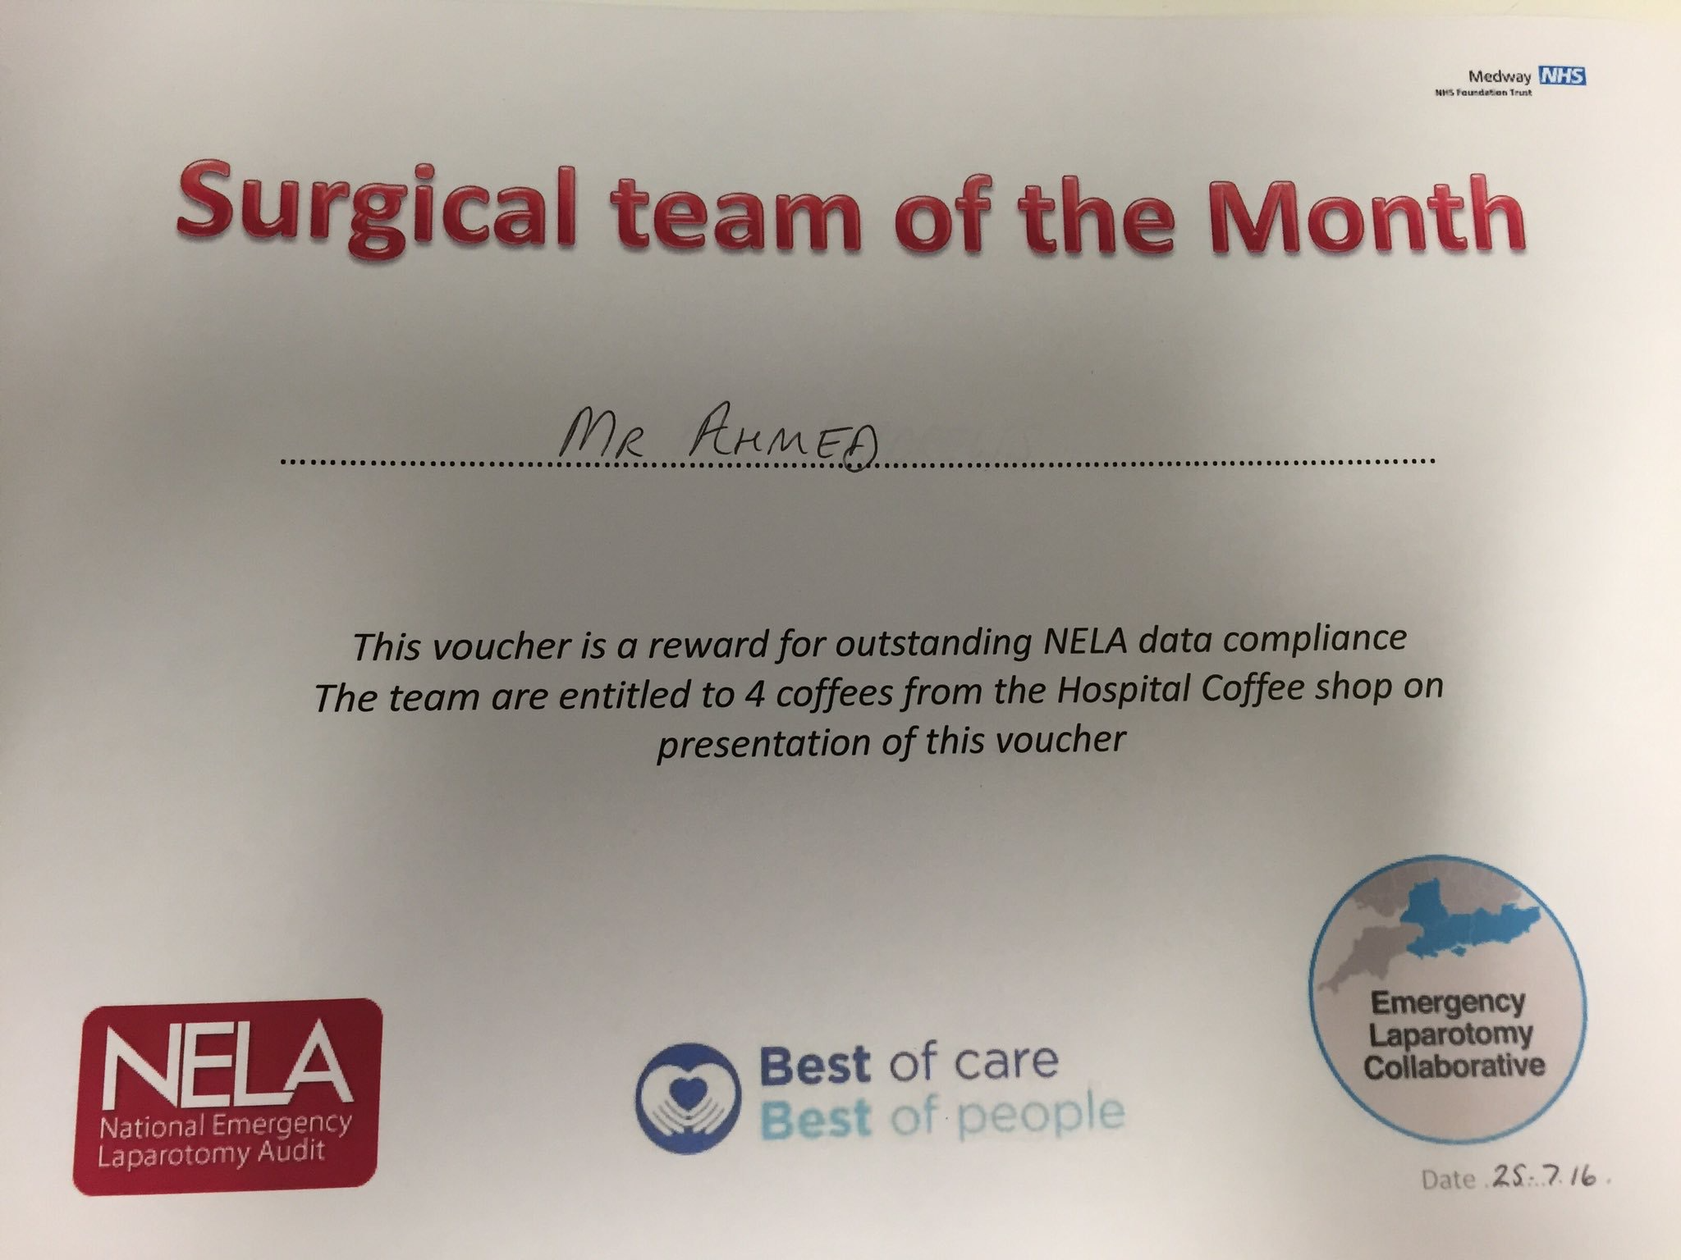
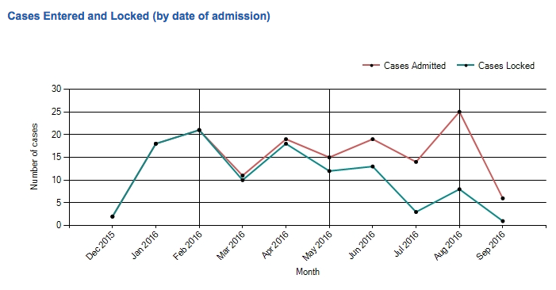
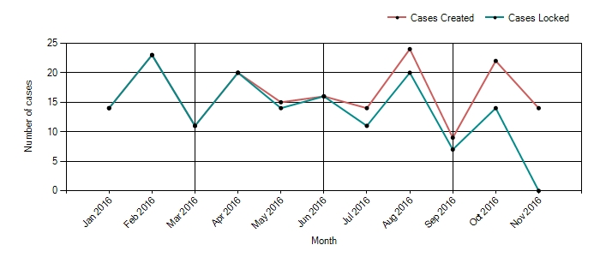
Team of the month
Notes:
Promotes discussion
Promotes ownership
Pride in work being done
Friendly competition and pushing each other to do better for our patients

Slide 23
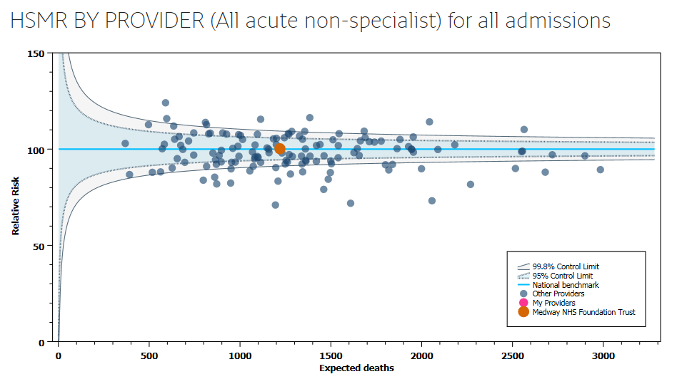
Has it all worked?
Year 2 = 10%
Year 3 (to date) = 11%
HSMR 100.19
Sept 2016
Notes:
Observed v expected year 2 = 62%
Observed v expected year 3 = 65%
Added effect of other specialities awareness of NELA,
Requests for us to ‘do the same’ for other pathologies and patient groups
Pride in the operating theatres for being recognised which improves Morale – more of a ‘can do’ feel.

Slide 24
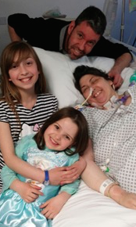
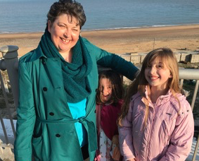
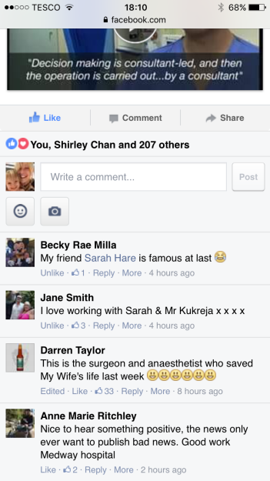
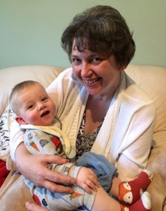
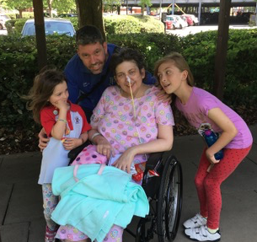
8th April
23rd April
9th July
15th October

Slide 25
With thanks to our Team
Neil Kukreja
Hayley Usmar
Laura Bennett
Shouphyna Ryan
Richard Dickson Lowe
Anil Ghosh
Paul Hayden
Fabian Sebastian
Laura Shell
Ann Smith

